Slide 1
Grid Data Visualization in Python

Slide 2
essential Python libraries / modules

Slide 3
matplotlib
a comprehensive library for creating static, animated, and interactive visualizations in Python
documentation: https://matplotlib.org/

Slide 4
cartopy
a Python package designed for geospatial data processing in order to produce maps and other geospatial data analyses.
documentation: https://scitools.org.uk/cartopy/docs/latest/

Slide 5
GeoPandas
a Python package that extends the datatypes used by the popular data science library pandas to allow spatial operations on geometric types
documentation: https://geopandas.org/en/stable/

Slide 6
Plotting

Slide 7
### import libraries / modules import os
import pygrib
from datetime import datetime as dt, timedelta import numpy as np
import geopandas as gpd
import cartopy.crs as ccrs from cartopy.mpl.gridliner import LONGITUDE_FORMATTER, LATITUDE_FORMATTER
import matplotlib as mpl import matplotlib.pyplot as plt import matplotlib.ticker as mticker

Slide 8
### Initialization datetime init = '202307200000' init_date = dt.strptime(init, '%Y%m%d%H%M') ### Data Stream and Input directory dts = 'a2' indir = f'/home/nms/ecmwf/data/{dts}/{init}' ### List valid forecast hours fhours = list(range(1,90+1,1)) + list(range(93,144+3,3)) + list(range(150,168+6,6))

Slide 9
### Loop through valid forecast hours to create plot for fhour in fhours: ### Get forecast hour interval if fhour in list(range(1,90+1,1)): i=1 elif fhour in list(range(93,144+3,3)): i=3 elif fhour in list(range(150,168+6,6)): i=6 print(f'i:{i}, forecast hour: {fhour}')

Slide 10
### Open gribfile, select parameter, extract and process data values if fhour==1: file_i = f'A2D{init_date:%m%d%H00}{init_date+timedelta(hours=fhour):%m%d%H00}1' grbs_i = pygrib.open(f'{indir}/{file_i}') grb_i = grbs_i.select(shortName='tp')[0]
val = grb_i.values*1000.0 else: file_i = f'A2D{init_date:%m%d%H00}{init_date+timedelta(hours=fhour):%m%d%H00}1' grbs_i = pygrib.open(f'{indir}/{file_i}') grb_i = grbs_i.select(shortName='tp')[0]
file_o = f'A2D{init_date:%m%d%H00}{init_date+timedelta(hours=fhour-i):%m%d%H00}1' grbs_o = pygrib.open(f'{indir}/{file_o}') grb_o = grbs_o.select(shortName='tp')[0]
val = (grb_i.values*1000.0) - (grb_o.values*1000.0)
### Extract lat, lon values lat, lon = grb_i.latlons()

Slide 11
### Initialize Figure fig = plt.figure(figsize=(12,12), dpi=70)
### Set map projection, extents and plot coastlines ax = plt.axes(projection=ccrs.PlateCarree()) ax.spines['geo'].set_linewidth(0.5) ax.set_ylim((lat[-1,::][0], lat[0,::][0])) ax.set_xlim((lon[::,0][0], lon[::,-1][0])) ax.coastlines(resolution='10m', color='black', linewidth=0.5)

Slide 12
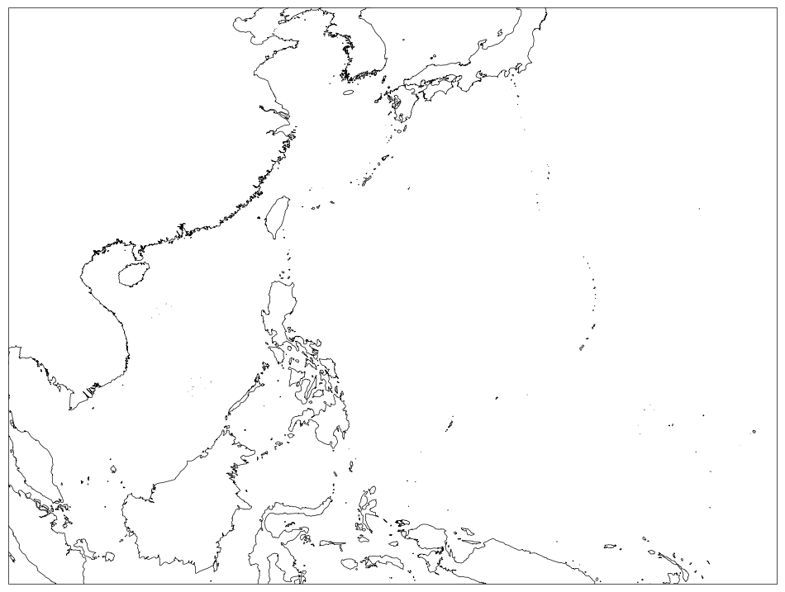

Slide 13
### Plot Domain Extents ## selected domain dom = 'whole_dom'
## extents of selected domain extents = {'whole_dom' : {'x': (100,160), 'y': (-5,40)}, 'PAR' : {'x':(115,135), 'y':(4,25)}, 'PH' : {'x':(116,128), 'y':(4,22)}, }

Slide 14
## selected domain dom = 'PAR' . . . ### Set map projection, extents and plot coastlines ax = plt.axes(projection=ccrs.PlateCarree()) ax.spines['geo'].set_linewidth(0.5) ax.set_ylim(extents[dom]['y']) ax.set_xlim(extents[dom]['x']) ax.coastlines(resolution='10m', color='black', linewidth=0.5)

Slide 15
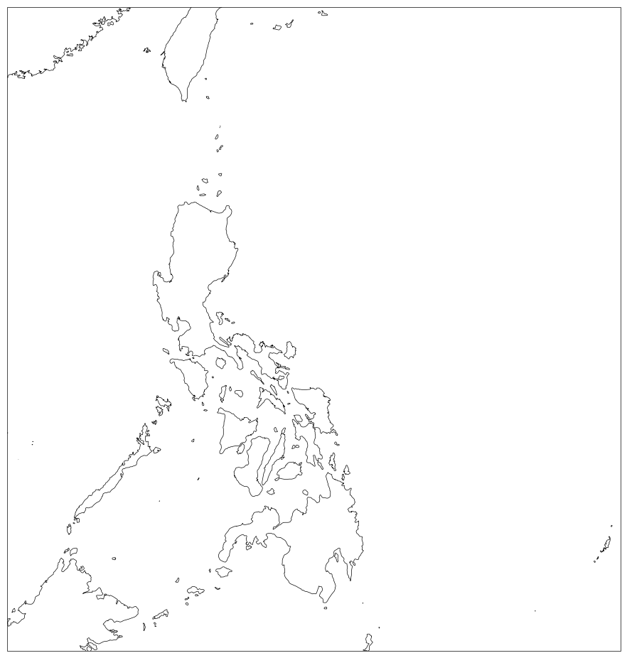

Slide 16
## selected domain dom = 'PH' . . . ### Set map projection, extents and plot coastlines ax = plt.axes(projection=ccrs.PlateCarree()) ax.spines['geo'].set_linewidth(0.5) ax.set_ylim(extents[dom]['y']) ax.set_xlim(extents[dom]['x']) ax.coastlines(resolution='10m', color='black', linewidth=0.5)

Slide 17
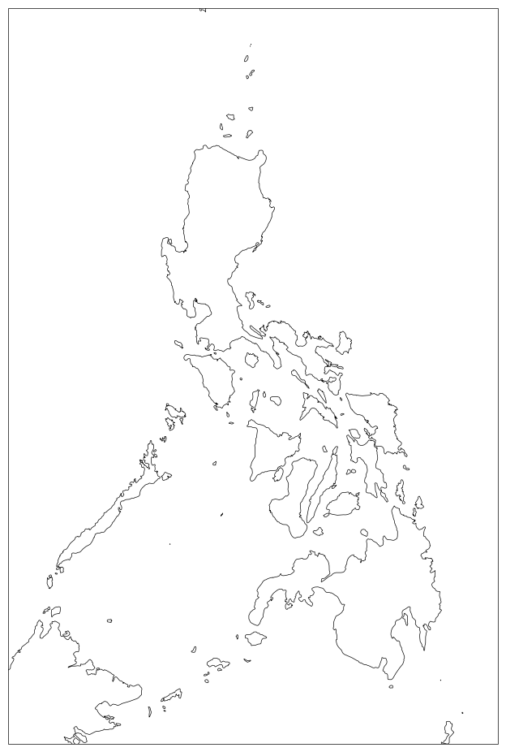

Slide 18
### Initialize Philippine provinces shapefile ph_shp = gpd.read_file('/home/nms/ecmwf/shapefiles/ph_province/province_laglake.shp') . . . ### Initialize Figure fig = plt.figure(figsize=(12,12), dpi=70) ### Set map projection, extents and plot coastlines ax = plt.axes(projection=ccrs.PlateCarree()) ax.spines['geo'].set_linewidth(0.5) ax.set_ylim(extents[dom]['y']) ax.set_xlim(extents[dom]['x']) ax.coastlines(resolution='10m', color='black', linewidth=0.5) ### Plot PH provinces ph_shp.plot(ax=ax, facecolor='none', edgecolor='#222222', linewidth=0.3, zorder=2)

Slide 19
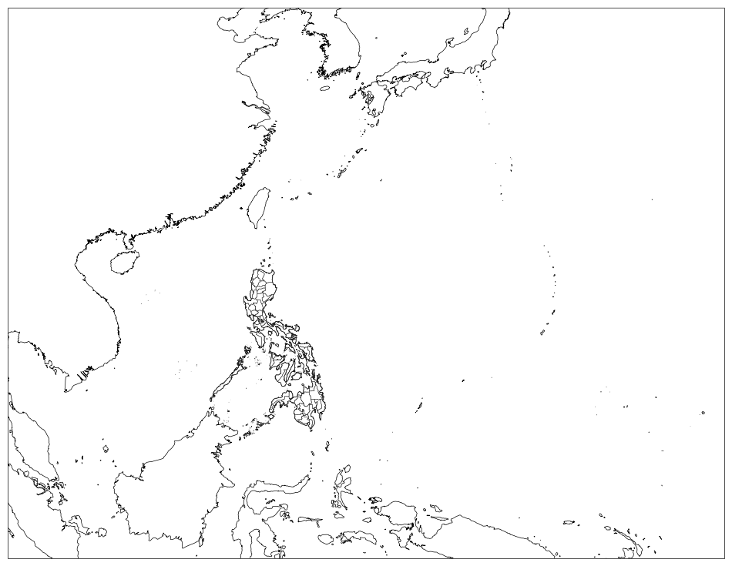

Slide 20
## for gridlines and labels of selected domain gls = {'whole_dom' : [5.0, -5, 40, 100, 160, 'gray'], 'PAR': [2.0, 4, 26, 114, 136, 'gray'], 'PH': [2.0, 4, 22, 116, 128, 'gray'] } . . . ### Plot grid lines and labels gl = ax.gridlines(draw_labels=True, linestyle=‘:’, linewidth=0, color='black') gl.top_labels = False gl.right_labels = False gl.xlocator = mticker.FixedLocator(list(np.arange(gls[dom][3],gls[dom][4],gls[dom][0]))) gl.ylocator = mticker.FixedLocator(list(np.arange(gls[dom][1],gls[dom][2],gls[dom][0]))) gl.xformatter = LONGITUDE_FORMATTER gl.yformatter = LATITUDE_FORMATTER gl.xlabel_style = {'size': 10, 'color': 'black'} gl.ylabel_style = {'size': 10, 'color': 'black'}

Slide 21
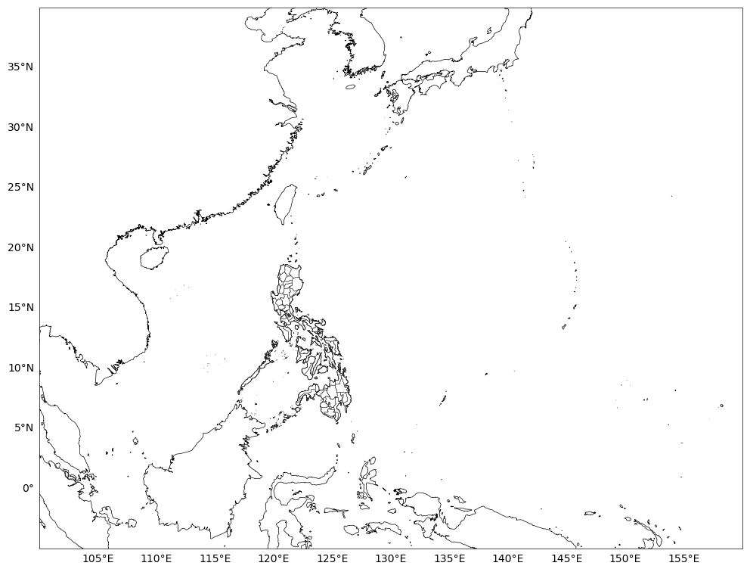

Slide 22
### Plot grid lines and labels
gl = ax.gridlines(draw_labels=True, linestyle=‘:’, linewidth=0.5, color='black') gl.top_labels = False gl.right_labels = False gl.xlocator = mticker.FixedLocator(list(np.arange(gls[dom][3],gls[dom][4],gls[dom][0]))) gl.ylocator = mticker.FixedLocator(list(np.arange(gls[dom][1],gls[dom][2],gls[dom][0]))) gl.xformatter = LONGITUDE_FORMATTER gl.yformatter = LATITUDE_FORMATTER gl.xlabel_style = {'size': 10, 'color': 'black'} gl.ylabel_style = {'size': 10, 'color': 'black'}

Slide 23


Slide 24
### Set colormap contour levels and colors: Accumulated Rainfall clevs = [0.01, 1.0, 2.5, 5.0, 7.5, 10, 15, 20, 30] ccols = ['#d9d9d9','#cccccc','#8cb2ff','#899bfa','#fefe1b','#feec19','#ffc20a','#ff9e0c'] cmap = mpl.colors.ListedColormap(ccols) cmap.set_over('#fa3c3c') cmap.set_under('white') colormap documentation: https://matplotlib.org/stable/users/explain/colors/colormap-manipulation.html
matplotlib list of named colors: https://matplotlib.org/stable/gallery/color/named_colors.html

Slide 25
### Plot parameter with pcolormesh plot = ax.pcolormesh(lon, lat, val, cmap=cmap, shading='nearest', norm=mpl.colors.BoundaryNorm(clevs, ncolors=cmap.N, clip=False)) pcolormesh documentation: https://matplotlib.org/stable/api/_as_gen/matplotlib.pyplot.pcolormesh.html

Slide 26
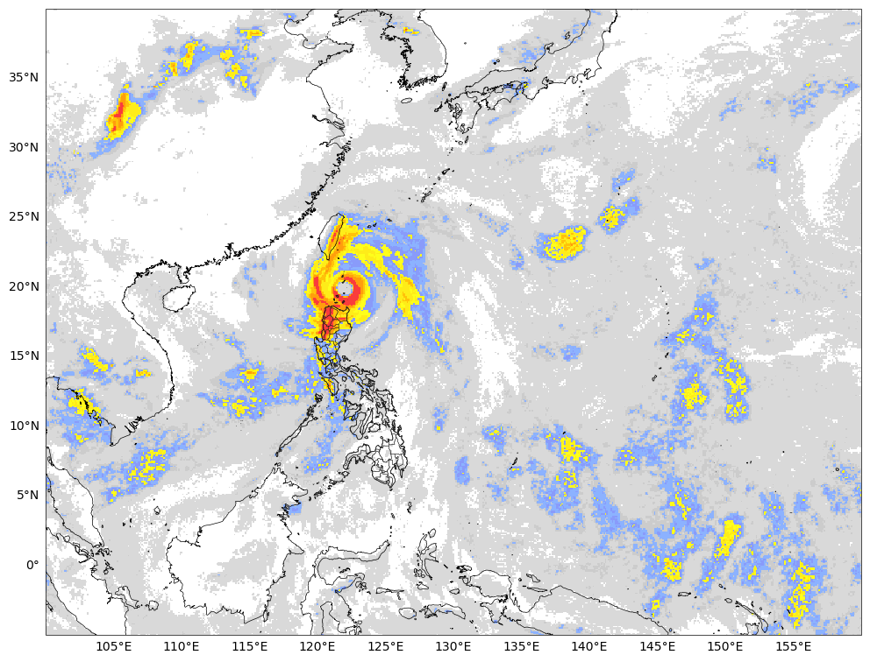

Slide 27
### Initialize and plot colorbar cbax = fig.add_axes([ax.get_position().x1+0.02, ax.get_position().y0, 0.011, ax.get_position().height]) cbar = plt.colorbar(plot, ticks=clevs, cax=cbax, orientation='vertical', drawedges=True, extendfrac='auto', extend='both') cbar.ax.tick_params(length=0, direction='out', color='black', labelsize=10, labelcolor='black') cbar.outline.set_linewidth(0.5) colorbar documentation: https://matplotlib.org/stable/api/_as_gen/matplotlib.pyplot.colorbar.html

Slide 28
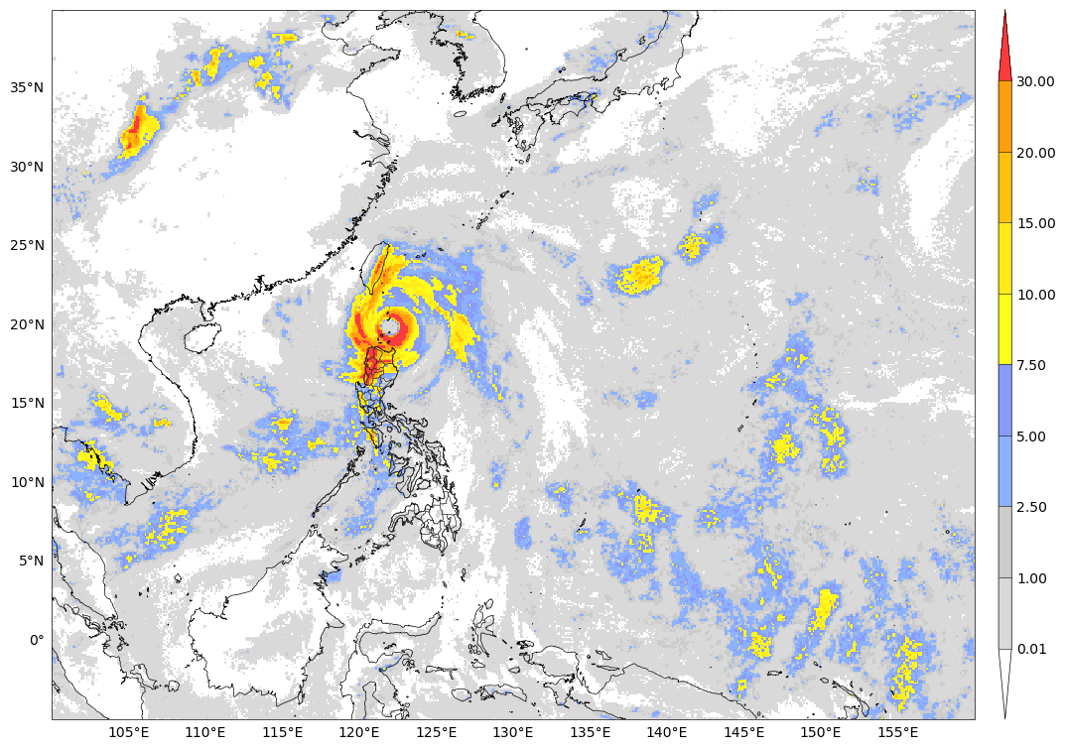

Slide 29
### Plot title text ax.set_title(f'ECMWF IFS 0.1deg\n{i}-Hour Accumulated Rainfall (mm)', loc='left', fontsize=12, pad=8) ax.set_title(f'{init_date+timedelta(hours=8)+timedelta(hours=fhour-i):%I%p %a %b-%d} to {init_date+timedelta(hours=8)+timedelta(hours=fhour):%I%p %a %b-%d} [T+{fhour:03d}]\nInitialization: {init}Z', loc='right', fontsize=12, pad=8) text in matplotlib: https://matplotlib.org/stable/users/explain/text/text_intro.html

Slide 30
### Create output directory outdir = f'/home/nms/ecmwf/plot/{dts}/{init}/{dom}' os.makedirs(outdir, exist_ok=True) . . .
### Save plot as image plt.savefig(f'{outdir}/ecmwf_tp_{init_date:%Y%m%d%H}_f{fhour:03d}_{init_date + timedelta(hours=fhour-i): %Y%m%d%H}_to_{init_date + timedelta(hours=fhour): %Y%m%d%H}', dpi=100, bbox_inches='tight')

Slide 31
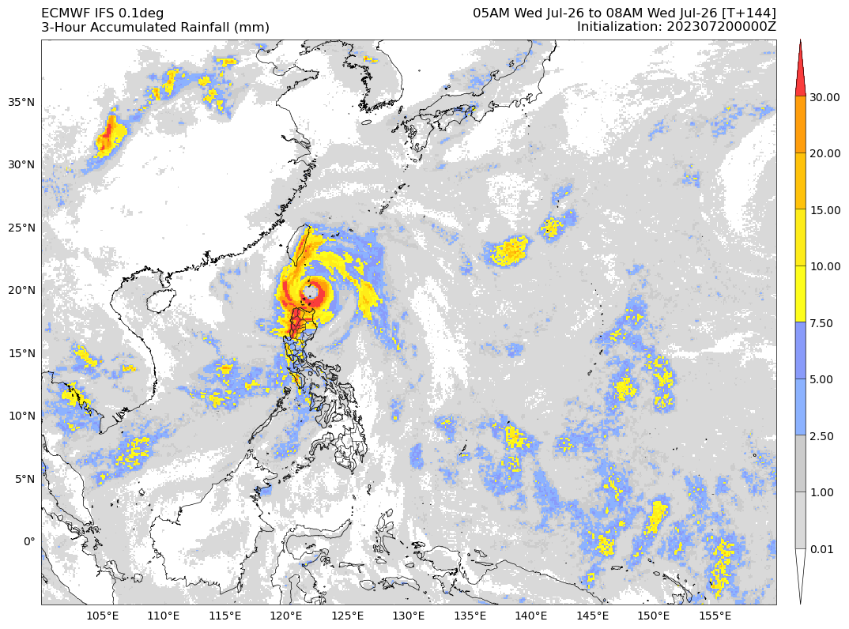

Slide 32
### Plot parameter with contourf plot = ax.contourf(lon, lat, val, levels=clevs, cmap=cmap, norm = mpl.colors.BoundaryNorm(clevs, ncolors=cmap.N, clip=False), extend='both') contourf documentation: https://matplotlib.org/stable/api/_as_gen/matplotlib.pyplot.contourf.html

Slide 33
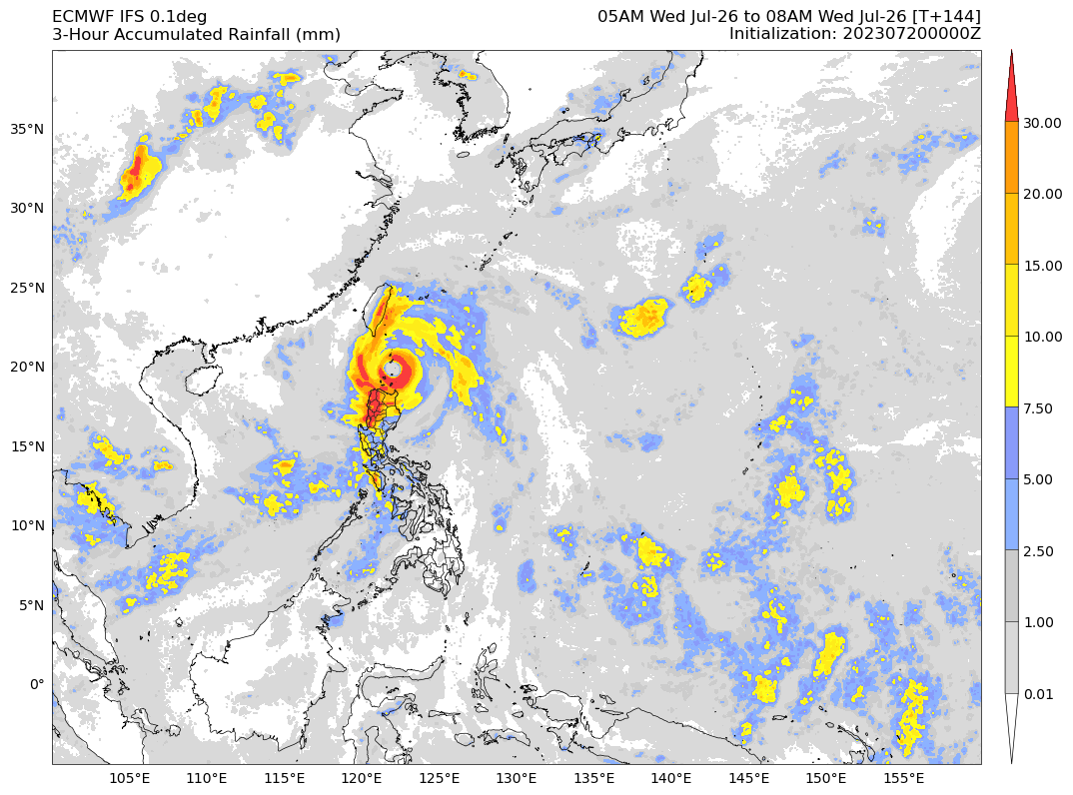

Slide 34
Other Plots

Slide 35
Winds

Slide 36
### Open gribfile, select parameter, extract and process data values file = f'A2D{init_date:%m%d%H00}{init_date+timedelta(hours=fhour):%m%d%H00}1' grbs = pygrib.open(f'{indir}/{file}') grb_u = grbs.select(shortName='10u')[0] grb_v = grbs.select(shortName='10v')[0] u = grb_u.values v = grb_v.values val = (u**2 +v**2) ** 0.5 ### Extract lat, lon values lat, lon = grb_u.latlons()

Slide 37
### Set colormap contour levels and colors: 10m Winds clevs = [0,0.3,1.6,3.4,5.5,8,10.8,13.9,17.2,20.8,24.5,28.5,32.7] ccols = ['#ffffff', '#f6f6f8', '#e5e6f5', '#cad8ec', '#669cba', '#229d4a', '#7ade00', '#f38e08', '#f84173', '#d43dd4', '#8f288e', '#2b2b2b'] cmap = mpl.colors.ListedColormap(ccols) cmap.set_over('#7d7d7e') ### Plot parameter with pcolormesh plot = ax.pcolormesh(lon, lat, val, cmap=cmap, shading='nearest', norm=mpl.colors.BoundaryNorm(clevs, ncolors=cmap.N, clip=False))

Slide 38
### Initialize and plot colorbar cbax = fig.add_axes([ax.get_position().x1+0.02, ax.get_position().y0, 0.011, ax.get_position().height]) cbar = plt.colorbar(plot, ticks=clevs, cax=cbax, orientation='vertical', drawedges=True, extendfrac='auto', extend='max') cbar.ax.tick_params(length=0, direction='out', color='black', labelsize=10, labelcolor='black') cbar.outline.set_linewidth(0.5)

Slide 39
### Plot title text ax.set_title(f'ECMWF IFS 0.1deg\n10m Wind Speed (mps)', loc='left', fontsize=12, pad=8) ax.set_title(f'{init_date+timedelta(hours=8)+timedelta(hours=fhour-i):%I%p %a %b-%d} to {init_date+timedelta(hours=8)+timedelta(hours=fhour):%I%p %a %b-%d} [T+{fhour:03d}]\nInitialization: {init}Z', loc='right', fontsize=12, pad=8) ### Save plot as image plt.savefig(f'{outdir}/ecmwf_tp_{init_date:%Y%m%d%H}_f{fhour:03d}_{init_date + timedelta(hours=fhour-i): %Y%m%d%H}_to_{init_date + timedelta(hours=fhour): %Y%m%d%H}', dpi=100, bbox_inches='tight')

Slide 40
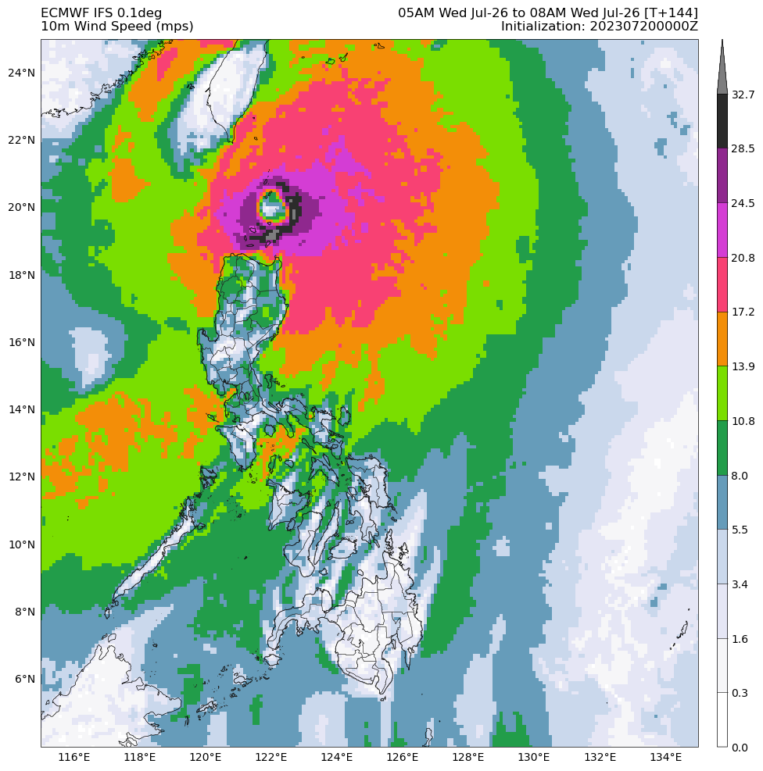

Slide 41
### Plot parameter with pcolormesh plot = ax.pcolormesh(lon, lat, val, cmap=cmap, shading='nearest', norm=mpl.colors.BoundaryNorm(clevs, ncolors=cmap.N, clip=False))
## Plot with streamlines ax.streamplot(lon, lat, u, v, density=2., linewidth=0.4, color='#252525', arrowsize=1, arrowstyle='->') streamplot documentation: https://matplotlib.org/stable/api/_as_gen/matplotlib.pyplot.streamplot.html

Slide 42
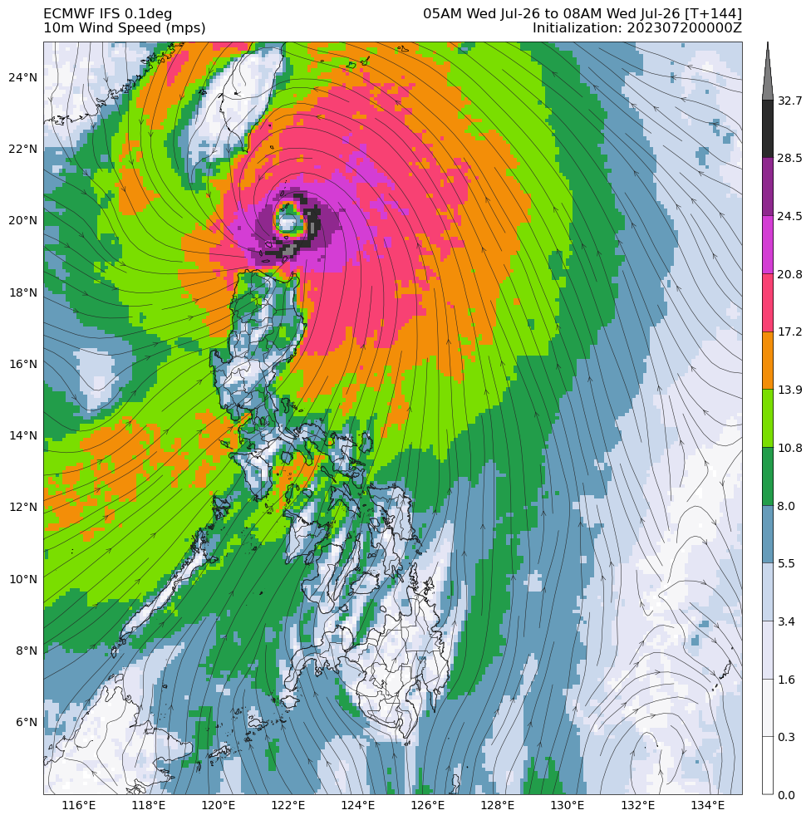

Slide 43
### Plot parameter with pcolormesh plot = ax.pcolormesh(lon, lat, val, cmap=cmap, shading='nearest', norm=mpl.colors.BoundaryNorm(clevs, ncolors=cmap.N, clip=False))
## Plot with wind barbs ax.barbs(lon, lat, u, v, barbcolor='#404040', flagcolor='#404040', linewidth=0.5, regrid_shape=20) barbs documentation: https://matplotlib.org/stable/api/_as_gen/matplotlib.pyplot.barbs.html

Slide 44
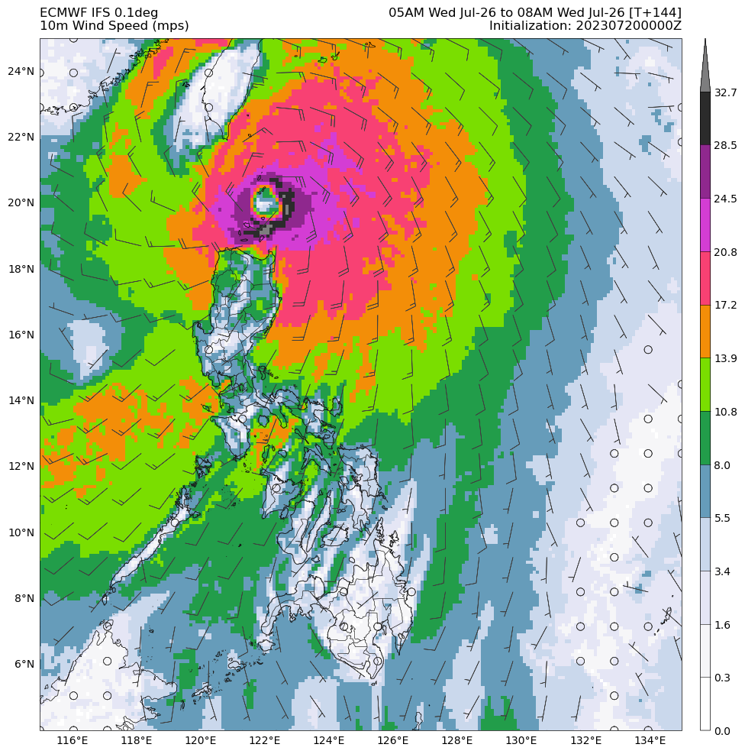

Slide 45
Mean Sea Level Pressure

Slide 46
### Open gribfile, select parameter, extract and process data values file = f'A2D{init_date:%m%d%H00}{init_date+timedelta(hours=fhour):%m%d%H00}1' grbs = pygrib.open(f'{indir}/{file}') grb = grbs.select(shortName='msl')[0] val = grb.values / 100.0 ### Extract lat, lon values lat, lon = grb.latlons()

Slide 47
### Set MSLP contour levels ### Plot MSLP with contour pres1_lev = list(range(950,990,4)) + list(range(990,1000,2)) pres1 = ax.contour(lon, lat, val, levels=pres1_lev, colors='red', linewidths=0.8) ax.clabel(pres1, fmt='%1.0f', fontsize=10, colors='black', inline_spacing=6)
pres2_lev = list(range(1002,1010,2)) + list(range(1014,1020,2)) + list(range(1020,1050,4)) pres2 = ax.contour(lon, lat, val, levels=pres2_lev, colors='blue', linewidths=0.8) ax.clabel(pres2, fmt='%1.0f', fontsize=10, colors='black', inline_spacing=6)
pres3_lev = [1010,1012] pres3 = ax.contour(lon, lat, val, levels=pres3_lev, colors='cyan', linewidths=0.8) ax.clabel(pres3, fmt='%1.0f', fontsize=10, colors='black', inline_spacing=6)
pres4_lev = [1000] pres4 = ax.contour(lon, lat, val, levels=pres4_lev, colors='orange', linewidths=0.8) ax.clabel(pres4, fmt='%1.0f', fontsize=10, colors='black', inline_spacing=6)

Slide 48
contour documentation: https://matplotlib.org/stable/api/_as_gen/matplotlib.pyplot.contour.html

Slide 49
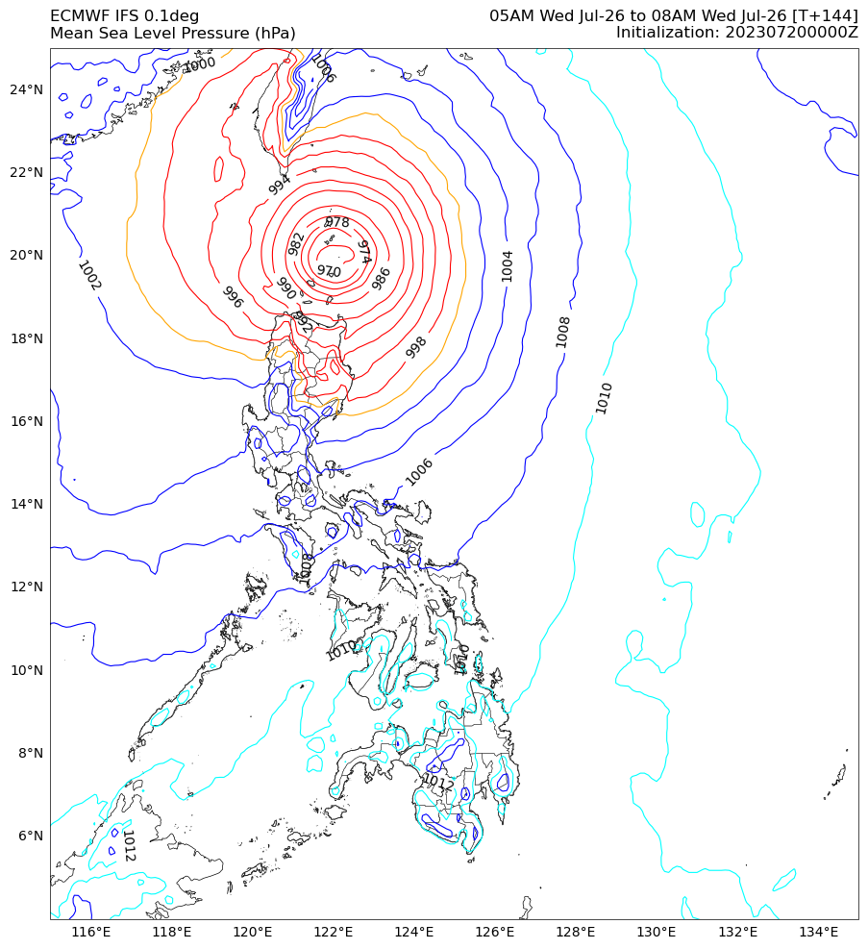

Slide 50
PQPF

Slide 51
### Open numpy file val = np.load(f'{indir}/ecmwf_pqpf7.5_{init_date: %Y%m%d%H}_f{fhour: 03d}_{init_date + timedelta(hours=fhour): %Y%m%d%H}.npy')
### Open lat, lon numpy files lat = np.load('/home/nms/ecmwf/scripts/ecmwf_lats.npy') lon = np.load('/home/nms/ecmwf/scripts/ecmwf_lons.npy') ### Set colormap contour levels and colors: PQPF clevs = [0.0, 0.05, 0.1, 0.2, 0.3, 0.4, 0.5, 0.6, 0.7, 0.8, 0.9, 1.0] ccols = ['#ffffff', '#d4d6d4', '#b4caff', '#8cb2ff', '#899bfa', '#a9d158', '#ebf4ac', '#fee518', '#ffd22c', '#ff9e0c', '#fc4e2a'] cmap = mpl.colors.ListedColormap(ccols)
### Plot parameter with pcolormesh plot = ax.pcolormesh(lon, lat, val, cmap=cmap, shading='nearest', norm = mpl.colors.BoundaryNorm(clevs, ncolors=cmap.N, clip=False))

Slide 52
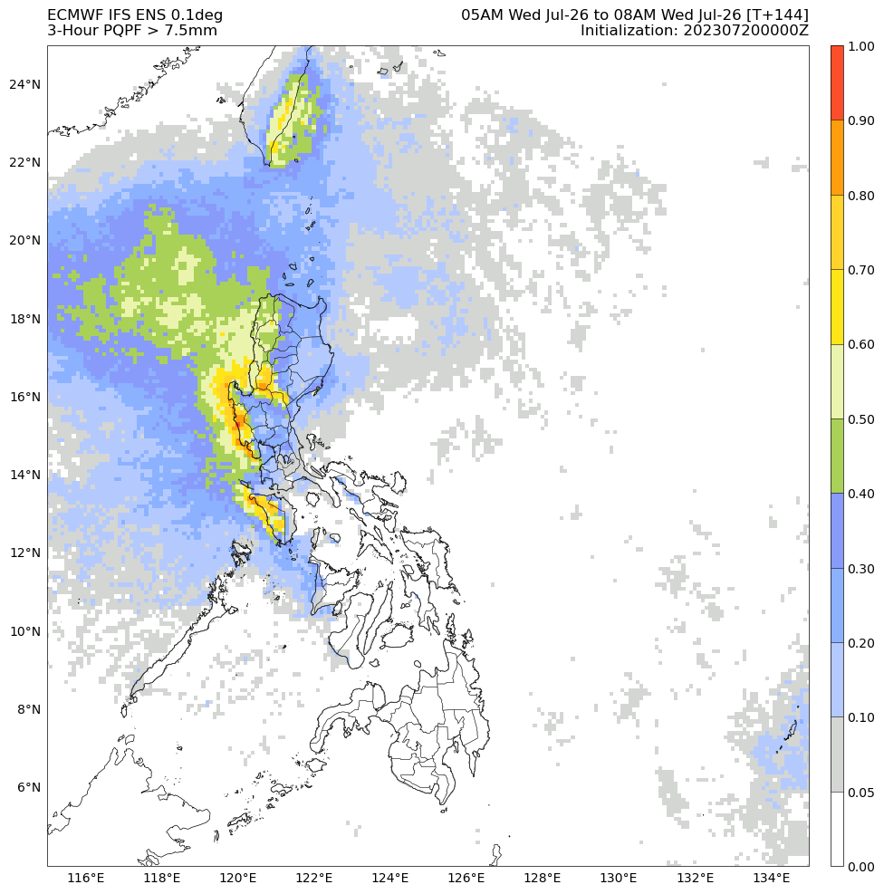

Slide 53
End

Slide 54
Ensemble Mean

Slide 55
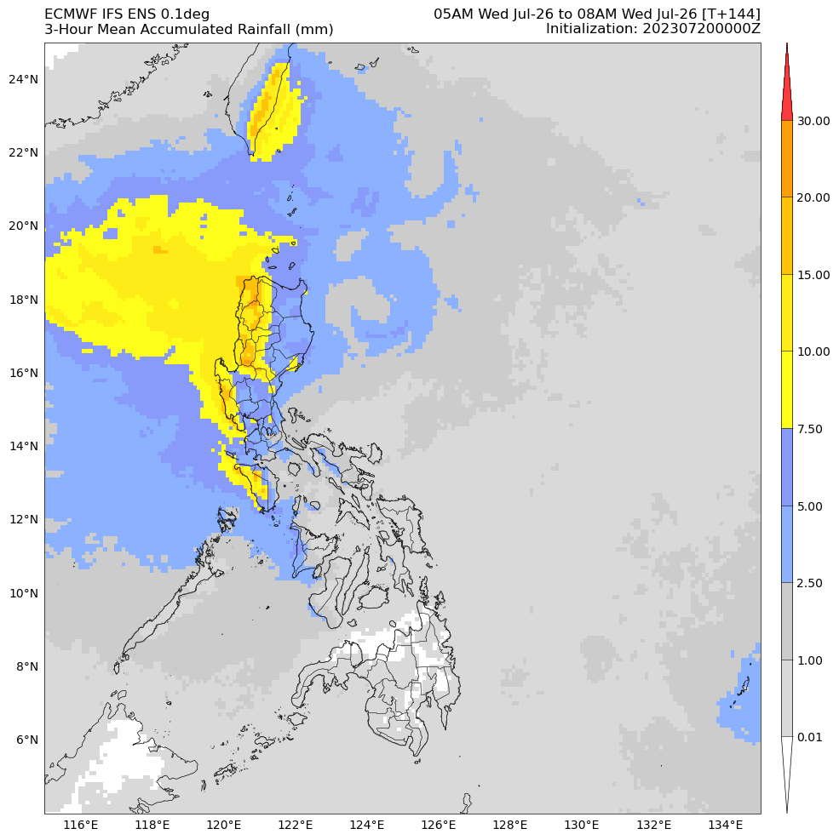

Slide 56
Multiple plots

Slide 57
